Slide 1
PM 2.5 forecasting in New delhi using Graph Neural Networks
Kacper Wyrwal s2031209@ed.ac.uk
May-July 2022

Slide 2
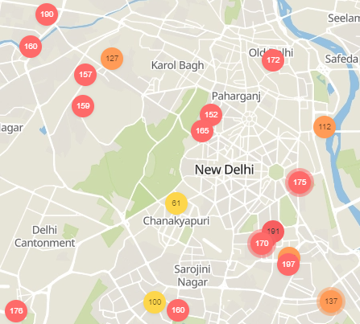
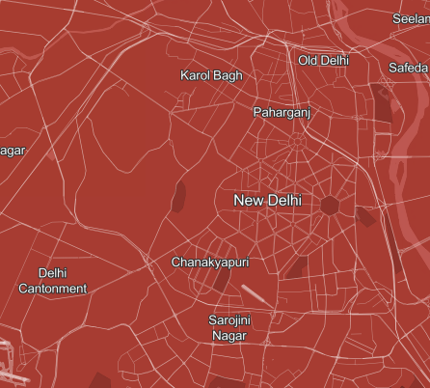
Problem Statement
time = 9:00
time = 9:15
GNN
Using PM 2.5 sparse geolocated PM 2.5 measurements we want to design a Graph Neural Network that predicts the PM 2.5 values forecasted into the near future (e.g. 15 minutes) at a much greater resolution.

Slide 3
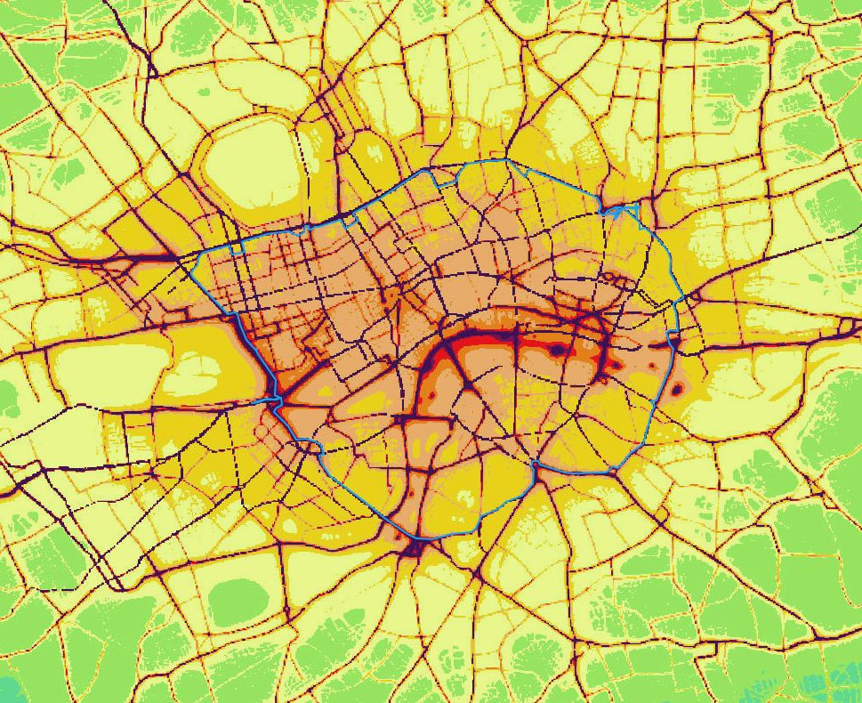
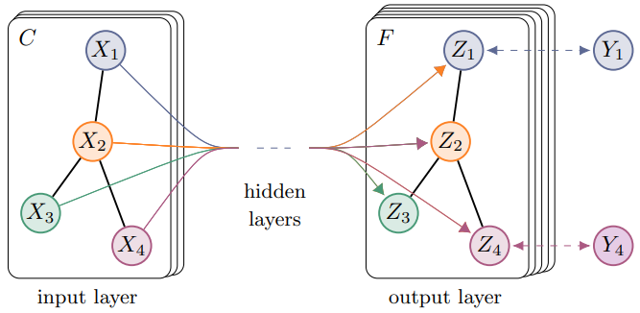
Motivation
Why GNN?
City data (e.g., road networks) is very naturally represented as a graph
Graph Neural Networks are a novel approach seeing a lot of success – notably on city data: ETA Prediction with Graph Neural Networks in Google Maps
GNNs have outperformed previous CNN-based approaches to long-distance pollution forecasting: Group-Aware Graph Neural Network for Nationwide City Air Quality Forecasting (arxiv.org)
Pollution in London tightly follows the road network.
What is novel about this project?
No one has used GNNs to perform pollution forecasting at such small distances and high resolutions.
No one has given a convincing method of evaluating the performance of a forecasting GNN in a semi-supervised setting – especially where the unlabeled to labeled ratio is very large e.g., 1000 to 1.
Semi-supervised tasks do not have fewer labels than nodes.

Slide 4
Data collection

Slide 5
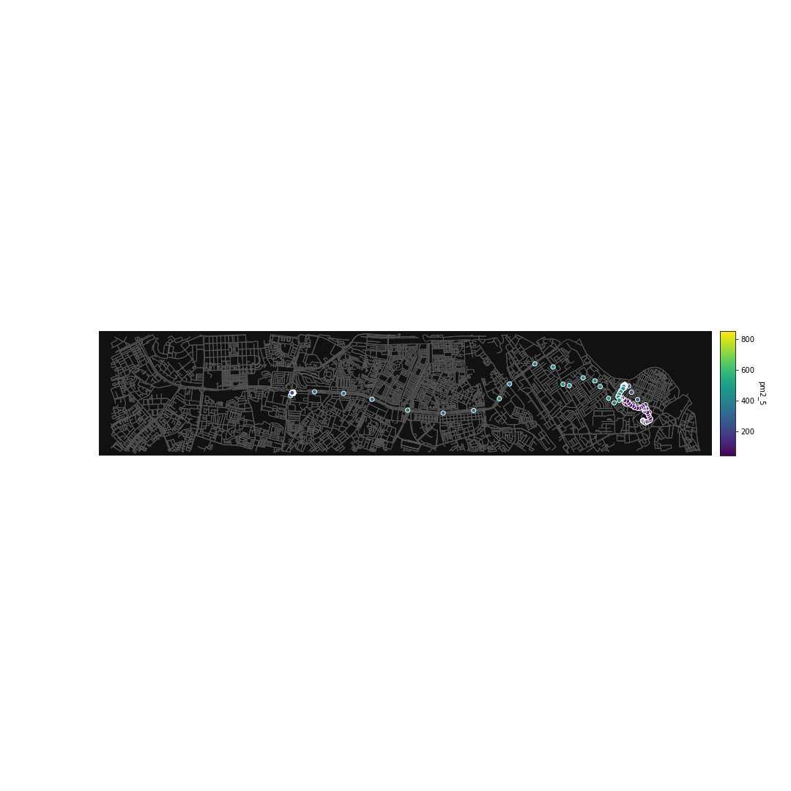
PM 2.5: DAPHNE dataset
Dataset overview
Geolocated PM 2.5 measurements in New Delhi
Data collected via AirSpeck sensors from 137 subjects
757950 data points between August 8th 2018 and February 1st 2020
Download from Datasync
Unique characteristics
Very high sampling frequency – 1 minute
Highly variable GPS positions – coordinates follow routes of 137 patients
Frequent periods with missing data
Example journey of the DAP002 patient

Slide 6
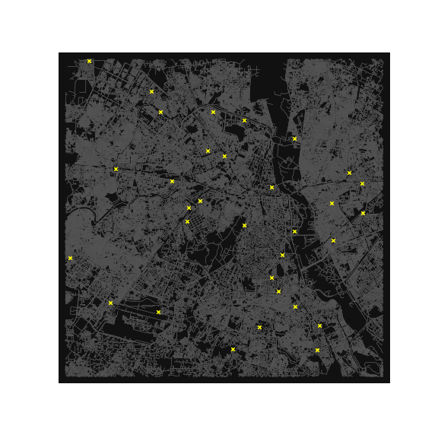

PM 2.5: CPCB dataset
Dataset overview
Geolocated PM 2.5 measurements in New Delhi
Data collected by 32 CPCB stations
973264 data points between January 1st 2019 and January 31st 2020
Download from Datasync
Unique characteristics
Medium sampling frequency – 15 minutes
Constant GPS positions – coordinates of stations do not change except when one is decommissioned or a new one is set up
Reliable data with few missing values
Locations of CPCB stations.

Slide 7
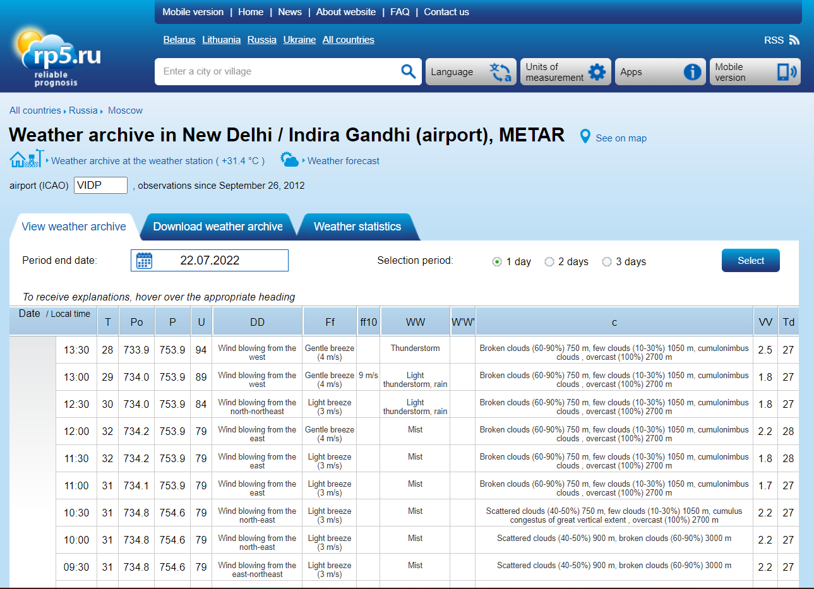
WEATHER: RP5.RU dataset
Dataset overview
Weather measurements at Indira Gandhi Airport
25411 data points between August 8th 2018 and January 31st 2020
Obtained via web scraping from rp5.ru (the website gives you a download option, but is currently nonfunctional)
Unique characteristics
Medium-low sampling frequency – 30 minutes
Very reliable data with few missing values
Various weather features: temperature, humidity, wind, wind direction, dewpoint, etc.

Slide 8
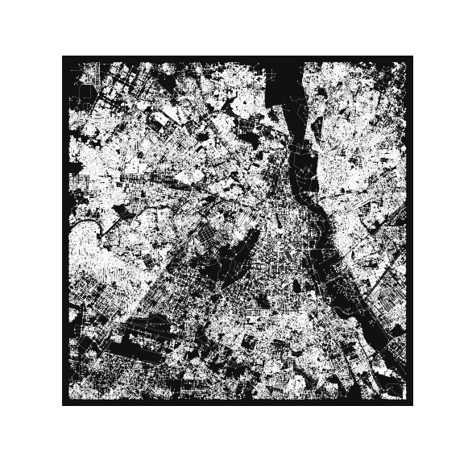
CITY TOPOLOGY: Open Street MAP GRAPH
Data overview
Graph of New Delhi, including roads, walkways, subway etc., with geolocated nodes
MultiDiGraph instance of the Networkx python library.
Around 180’000 nodes and 500’000 in a graph containing all CPCB stations.
Obtained via the OSMNX python library.
Unique characteristics
Various useful edge and node features: edge types ( e.g. highway), number of lanes, junction types, elevation of nodes
Processing a Networkx Graph may be slow – consider converting to GraphTool first
Graph of New Delhi obtained via OSMNX

Slide 9
Data Processing

Slide 10
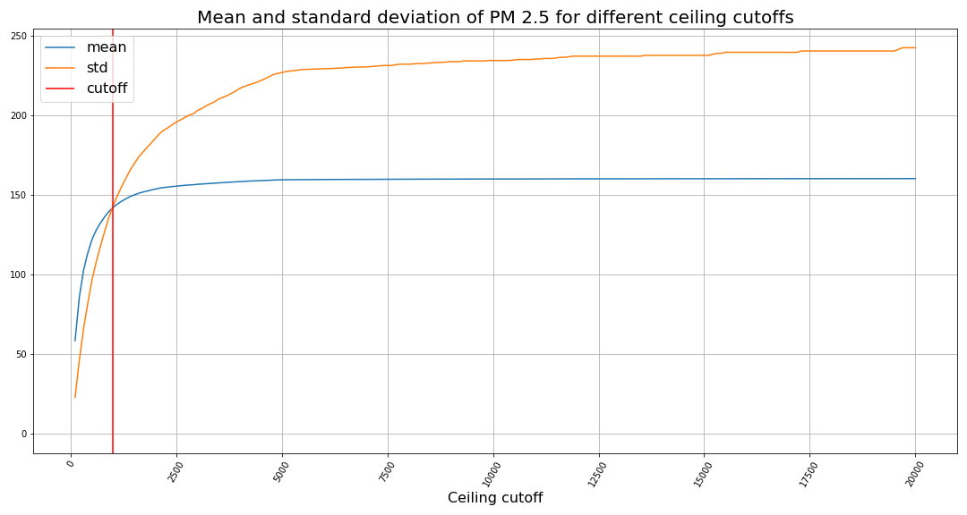
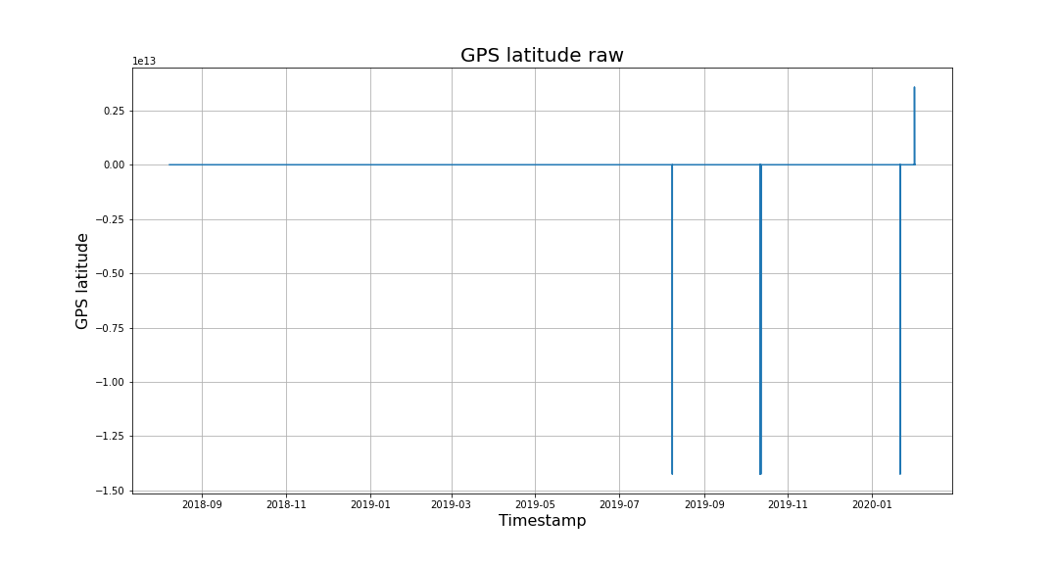
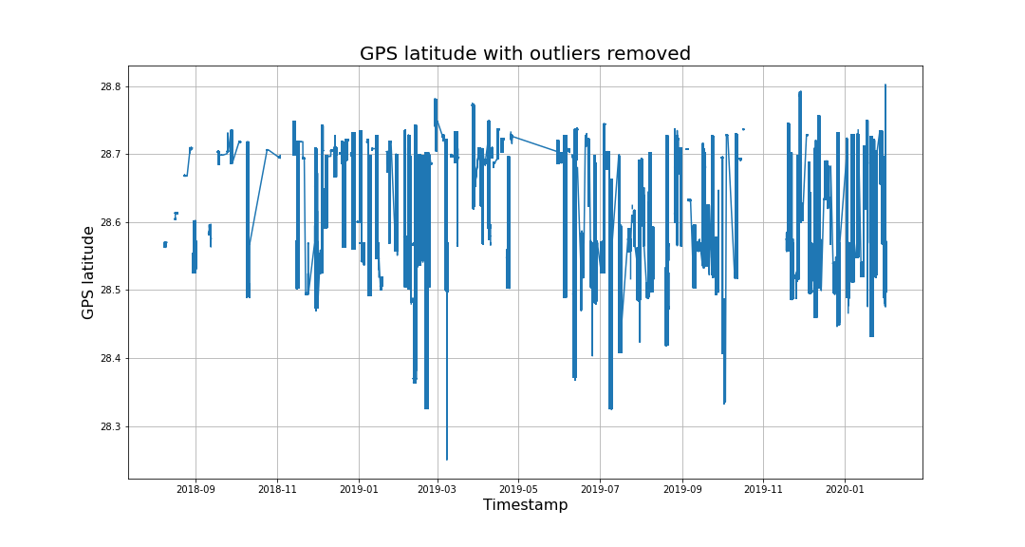
DAPHNE dataset
Raw DAPHNE data contains a lot of outliers; thus, we clean of columns of interest:
PM 2.5 – remove all values below 0 or above 1000. We choose not to task the GNN with learning short term spikes in PM 2.5.
GPS longitude – remove values more than 0.5º from the longitude of New Delhi (77.2167º).
GPS latitude – remove values more than 0.4º from the latitude of New Delhi (28.6448º).
PM 2.5 readings above 1000 are mostly spikes.

Slide 11
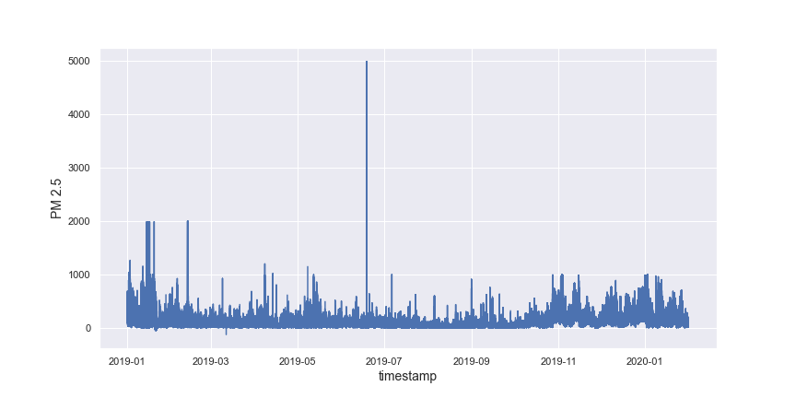
CPCB dataset
The quality of the CPCB dataset is very high; thus, we only need to combine all the files of individual stations as follows:
We transform the files in the June-July directory into format consistent with other files.
We combine the files in each time period directory, adding station name to each row.
We merge the combined files of each time period.
For each row we swap the station name for GPS coordinates of the station.
The CPCB dataset is already well behaved; however, one might still want to remove PM 2.5 values above a 1000.

Slide 12
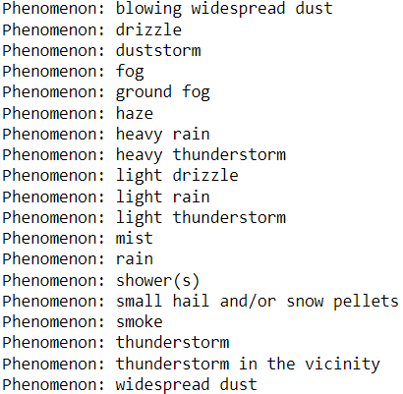
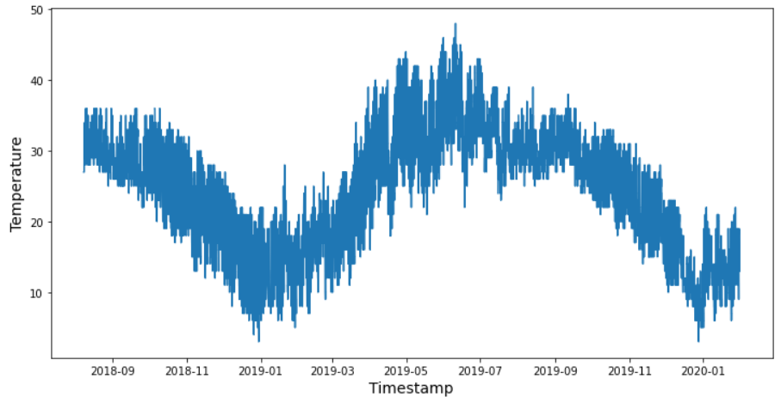
Weather dataset
The quality of the weather dataset is very high; thus, we only numerically encoded values in certain columns:
Visibility and Wind Speed – string values stripped retaining only numeric components
Wind Direction - one-hot encoded
Phenomenon – specially one-hot encoded to allow for multiple phenomena occurring at once
Phenomenon column converted into 19 one-hot-encoding columns
Weather data is already well behaved

Slide 13
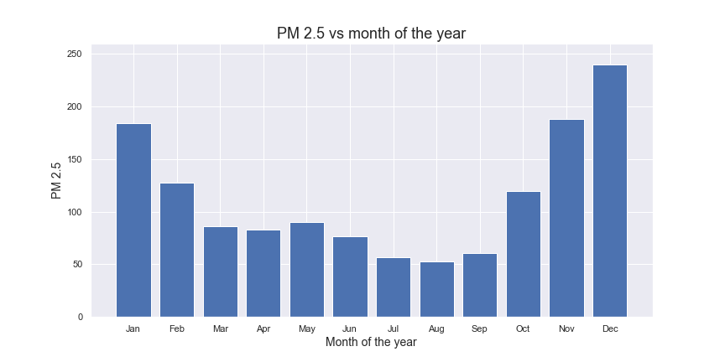
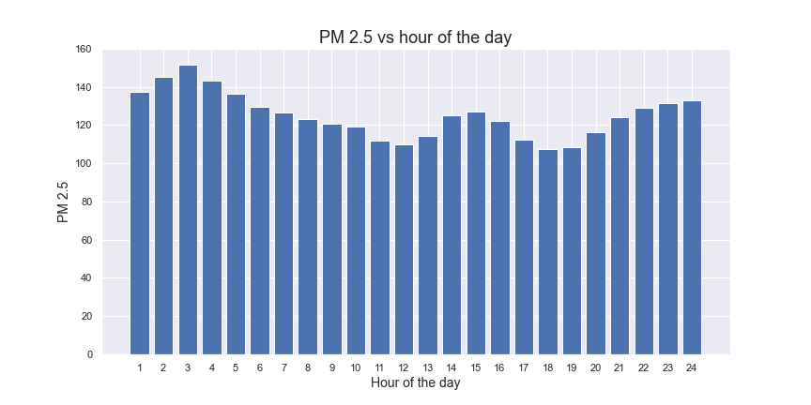
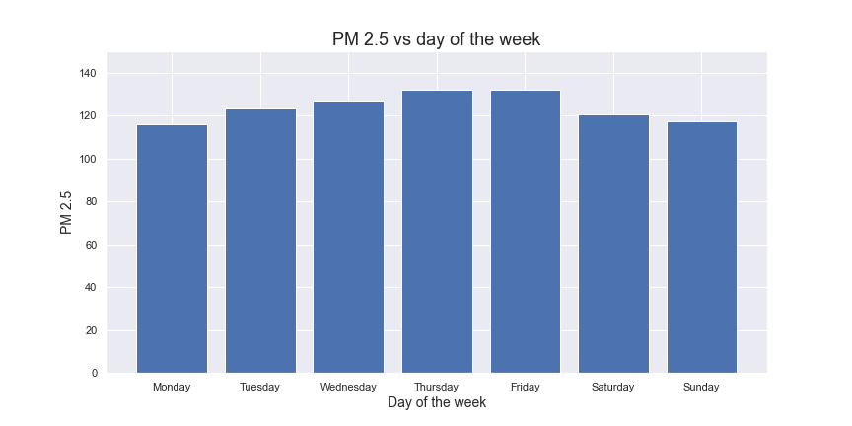
TIME features engineering
We chose to engineer the following features, since we see consistent differences in average PM 2.5 values as these varied:
Month – integer between 0 and 11
Day of the week – integer between 0 and 6
Hour of the day – integer between 0 and 23

Slide 14
Alignment of multiple datAsets with custom DATASET class
Dealing with multiple datasets at once presents a challenge of aligning the data in time. For this purpose, we have constructed the Dataset class.
The Dataset class first performs some preparation upon initialization:
Divides the datasets into n minutes long snapshots, ensuring that for each snapshot there is a weather reading within m minutes of its average timestamp.
Collects the snapshots into batches breaking the batch where the distance between snapshots is greater than n minutes.
Afterwards, individual Batch and Snapshot objects may be retrieved from the Dataset in constant time.
Weather
PM 2.5 + GPS
Snapshot
Dataset
Batch[key]
Dataset[key]
Time
GPS
Batch
Weather
PM 2.5

Slide 15
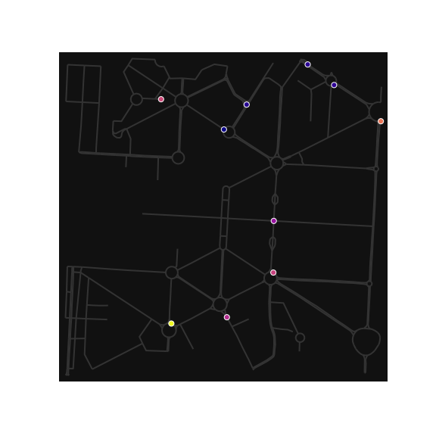
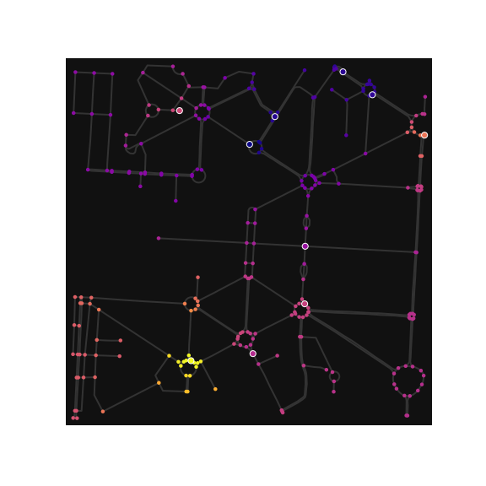
PM 2.5 interpolation onto a graph
Convolutional networks, due translation invariance of convolutional filters, do not work well with sparse inputs i.e., inputs with mostly zeros.
We attempt to alleviate this issue by interpolating the measured PM 2.5 values to graph nodes with no PM 2.5 values. A reasonable choice of interpolation is a mean weighted by inverse distance squared.
Example graph before and after interpolation (measurements circled in white).

Slide 16
Evaluation and learning in semi-supervised setting

Slide 17
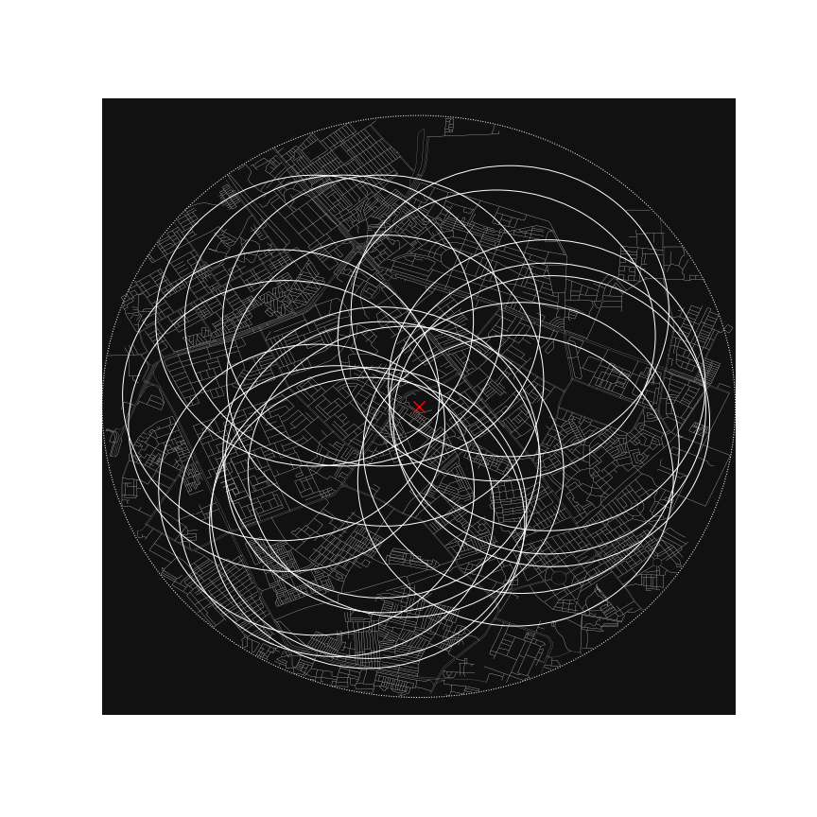
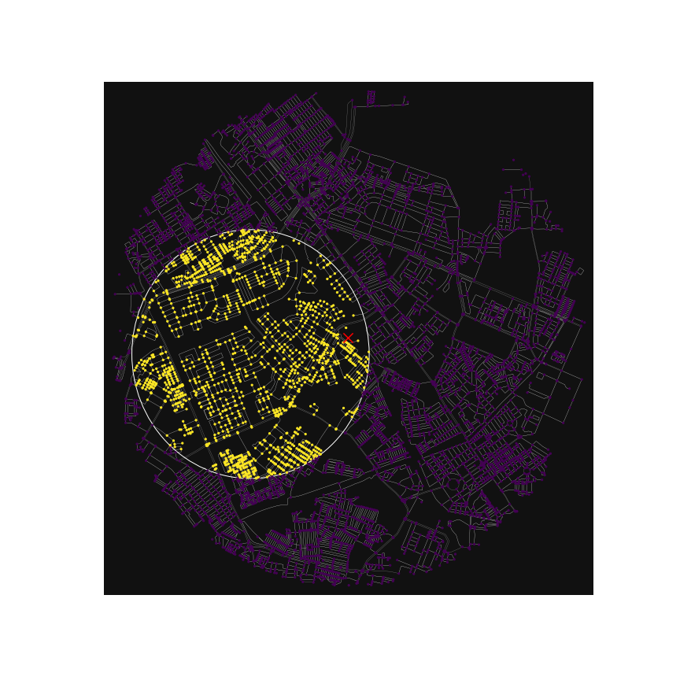
Graph Windows
Position of the label changes relative to the center of the windows.
In order to evaluate the GNN’s performance, we would like to have a label in a dense grid of positions across the graph.
This can be achieved in effect by limiting our scope to a smaller window of the large graph and sliding that window across the graph. As we do so, the position of the label within the window changes.
The idea is that, if the GNN predicts the value correctly for the label for each translation of the window, then it predicts the values correctly for the entire window.
In practice, we cut the windows from a Pytorch Geometric Temporal Data object rather than from a Networkx Graph object.

Slide 18
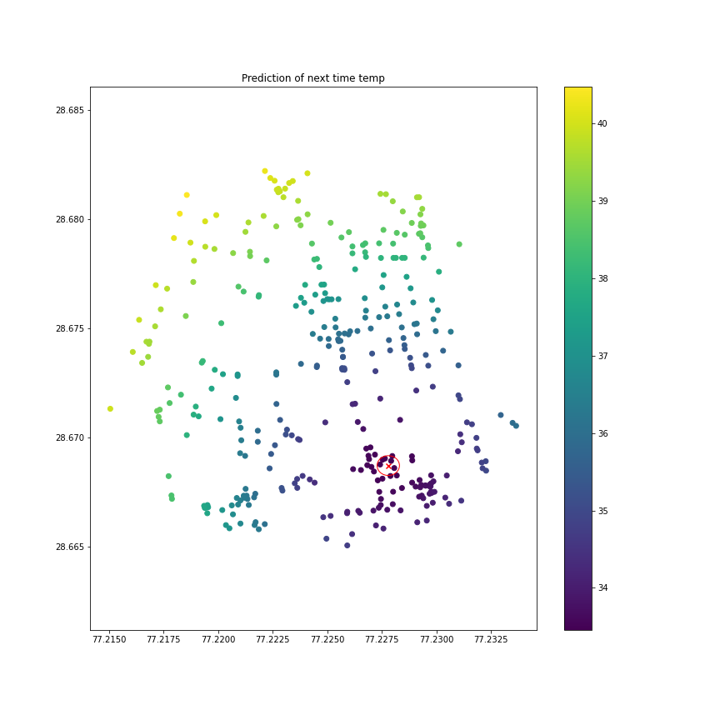
(weighted) MSE within radius
Many of the nodes in an input graph will be far away from labelled data; thus, most of them cannot be included in error calculation.
To address this issue, we created the RadMSELoss class (a subclass of PyTorch’s MSELoss) which includes only the nodes within a given radius from a label in the error calculation. The error being the average difference squared between the GNN’s outputs at the chosen nodes and their target values interpolated from the labels.
Moreover, the influence on the error of each node can be optionally weighted the inverse distance squared – representing our confidence in the similarity to the label decreasing with distance to it squared.
Only the nodes within the red circle (100 meters from a CPCB station) are included in error calculation.

Slide 19
PM 2.5 Forecasting

Slide 20
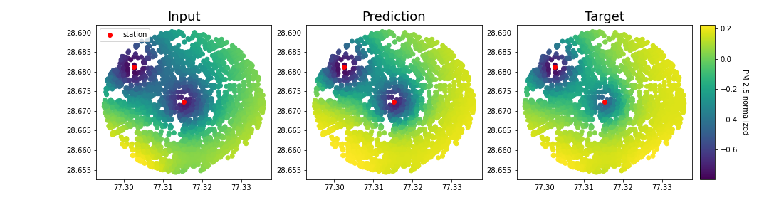
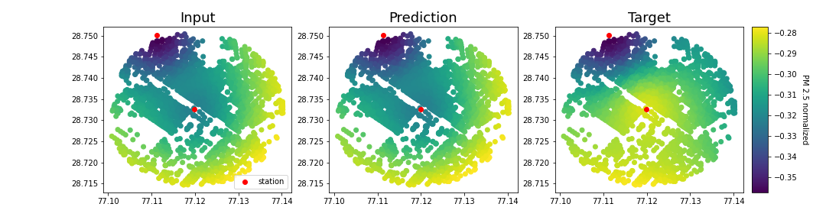
GNN(PM 2.5 graph) = PM 2.5 graph
Task: We constructed a simple Recurrent Graph Convolutional Network to forecast the PM 2.5 over the graph of New Delhi 15 minutes into the future. We extracted graph 2000 meters in radius around each CPCB station and trained the GNN on windows of those graphs.
Findings: The GNN predicts the next time step (15 minutes difference) on some sequences accurately. However, oftentimes it is doing so by approximating the identity function.
Going further: The GNN itself has only been trained for short periods of time (<1hr on a laptop). Thus, training the network on the entire dataset, on multiple windows, and with hyperparameter search could prove fruitful.
Replicating the inputs may be …
… but usually is not a great strategy in a forecasting task.

Slide 21
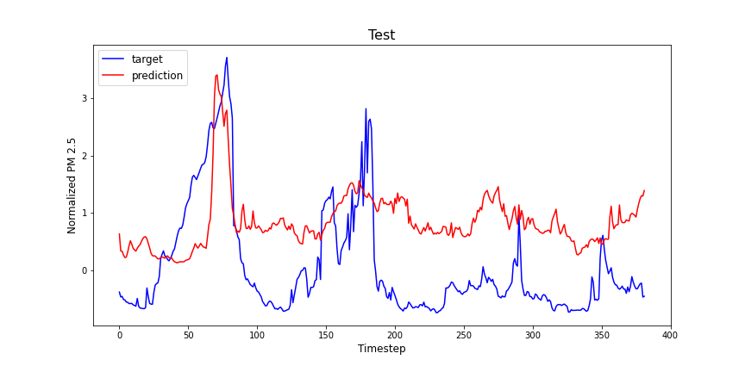
RNN(Weather, time) = PM 2.5
Task: We constructed a simple LSTM-based Recurrent Neural Network to predict the average PM 2.5 values in New Delhi given only weather and time information.
Findings: Evident from the graphs produced, weather and time data are a valuable predictor of PM 2.5 for a deep learning model. Thus, suggesting that their addition to the GNN model will likely improve its accuracy.
Going further: The RNN itself has not been extensively evaluated and no hyperparameter search was performed to improve its performance, which leaves an alleyway for further research.
Prediction on testing data suggests PM 2.5 predictive power of weather and time features.

Slide 22
Further research and improvements

Slide 23
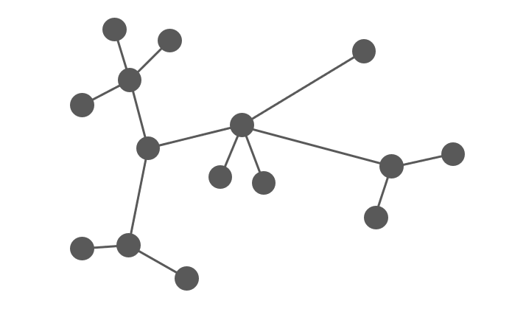
Adding time and weather to the GNN
n-node graph
weather+time
We have demonstrated that weather and time make valuable predictors of PM 2.5. Thus, it would be beneficial for the GNN to harvest this information.
We suggest two methods of achieving that:
Concatenate the time+weather feature vector onto the features of each node in the input graph.
Concatenate the outputs of the GNN and RNN before passing it through another RNN – ensuring joint learning.
GNN
Concatenate ouputs
RNN
RNN
n-length vector
GNN
Idea 2: Concatenate the outputs and feed them through another RNN. May be clever but requires the number of nodes in the input graph to be constant.
Idea 1: Each node wears the same hat of weather+time features. Simple, but wasteful.

Slide 24
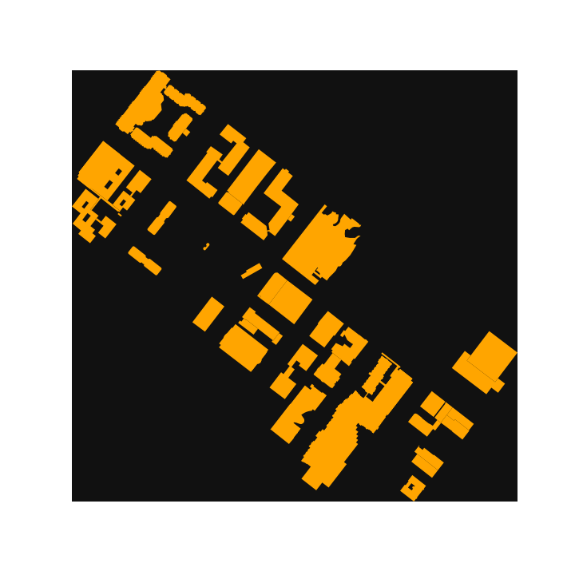
Heterogeneous graphs and long-distance dependencies
Heterogeneous graphs: We can try to improve the GNN’s performance by augmenting the data. One way of doing that is by adding multiple node types (school, park, etc.) and edge types (highway, bicycle path, etc.) – that is, by making the graph, and the GNN, heterogeneous.
Long-distance dependencies: So far, the GNN has been trained only on small graphs (~2000 meters radius); thus, it could not benefit from readings further away. One way to include these readings would be to construct an “overgraph” of all labelled positions and connect it to the current input graph (in a heterogenous graph, the “overgraph” nodes would be of a different type).
Footprints of buildings (obtained via osmnx) may be added to a heterogeneous graph.

Slide 25
Fin

